Slide 1
18CSC202J - OBJECT ORIENTED DESIGN AND PROGRAMMING Session 4 Topic :STL Iterators

Slide 2
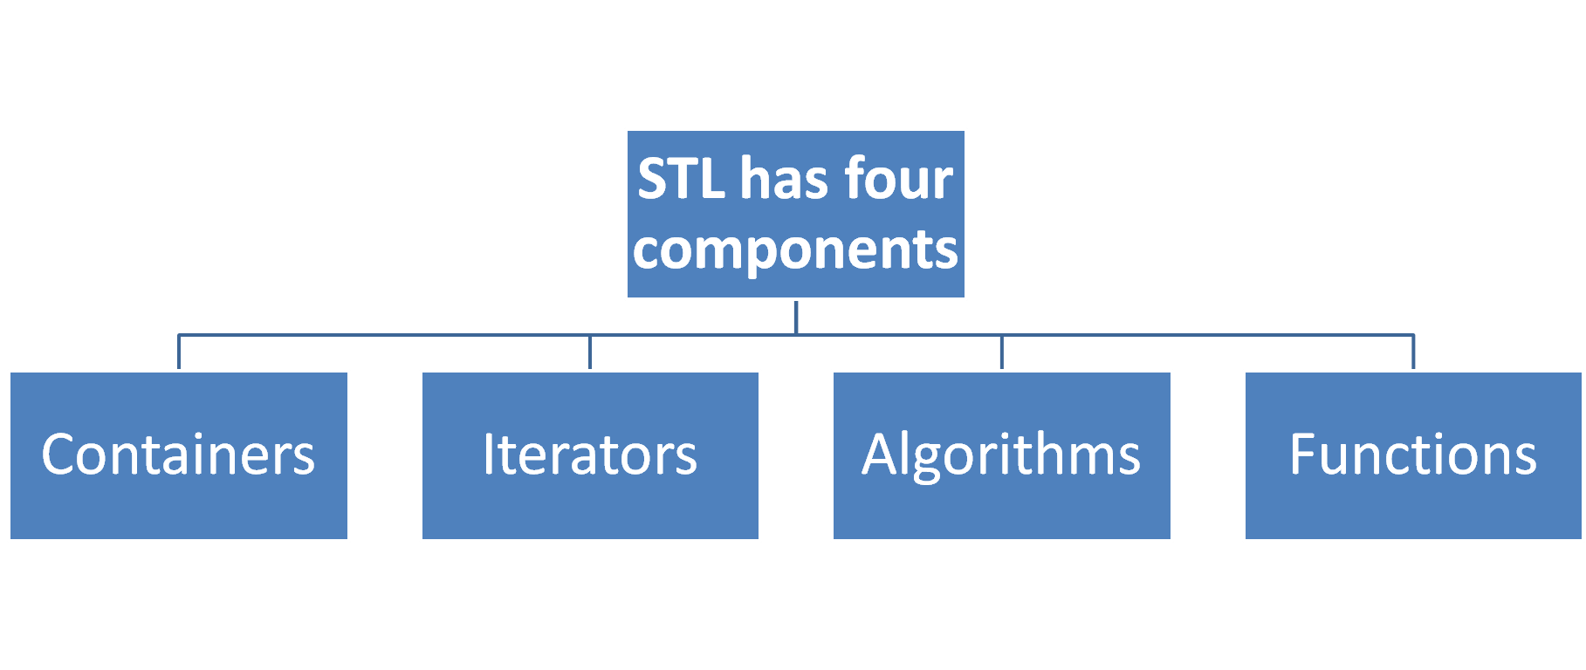

Slide 3
STL Iterators
Are used to point at the memory addresses of STL containers.
They are primarily used in sequence of numbers, characters etc.
They reduce the complexity and execution time of program.

Slide 4
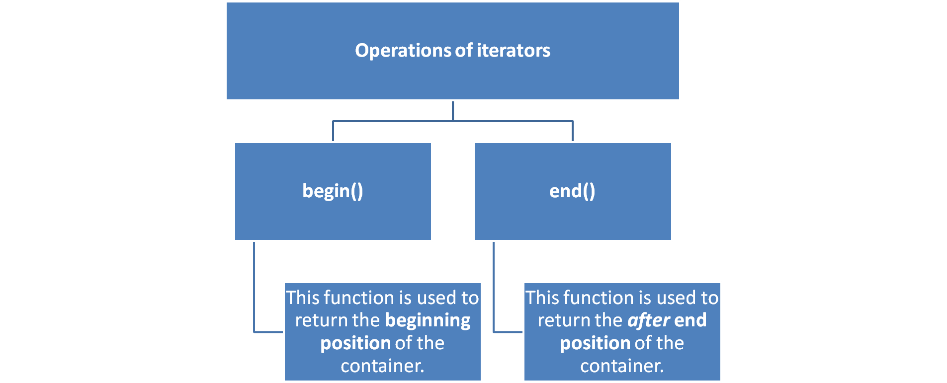

Slide 5
// C++ code to demonstrate the working of iterator, begin() and end()
#include<iostream>
#include<iterator> // for iterators
#include<vector> // for vectors
using namespace std;
int main()
{
vector<int> ar = { 1, 2, 3, 4, 5 };
// Declaring iterator to a vector
vector<int>::iterator ptr;
// Displaying vector elements using begin() and end()
cout << "The vector elements are : ";
for (ptr = ar.begin(); ptr < ar.end(); ptr++)
cout << *ptr << " ";
return 0;
}
Output:
The vector elements are : 1 2 3 4 5

Slide 6
advance() :- This function is used to increment the iterator position till the specified number mentioned in its arguments.
// C++ code to demonstrate the working of advance()
#include<iostream>
#include<iterator> // for iterators
#include<vector> // for vectors
using namespace std;
int main()
{
vector<int> ar = { 1, 2, 3, 4, 5 };
// Declaring iterator to a vector
vector<int>::iterator ptr = ar.begin();
// Using advance() to increment iterator position
// points to 4
advance(ptr, 3);
// Displaying iterator position
cout << "The position of iterator after advancing is : ";
cout << *ptr << " ";
return 0;
}
Output:
The position of iterator after advancing is : 4

Slide 7
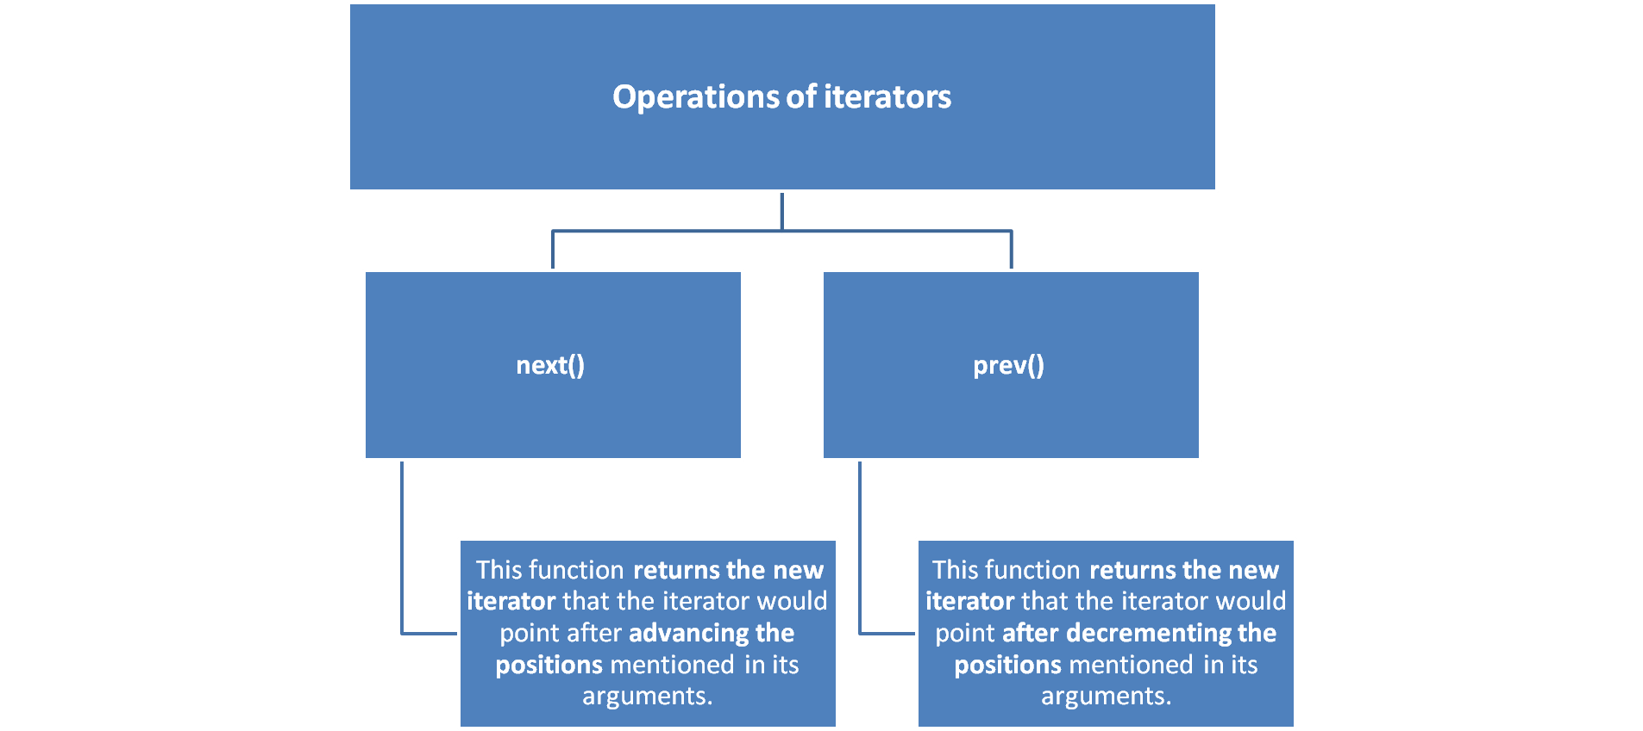

Slide 8
// C++ code to demonstrate the working of next() and prev()
#include<iostream>
#include<iterator> // for iterators
#include<vector> // for vectors
using namespace std;
int main()
{
vector<int> ar = { 1, 2, 3, 4, 5 };
// Declaring iterators to a vector
vector<int>::iterator ptr = ar.begin();
vector<int>::iterator ftr = ar.end();
// Using next() to return new iterator
// points to 4
auto it = next(ptr, 3);
// Using prev() to return new iterator
// points to 3
auto it1 = prev(ftr, 3);
// Displaying iterator position
cout << "The position of new iterator using next() is : ";
cout << *it << " ";
cout << endl;
// Displaying iterator position
cout << "The position of new iterator using prev() is : ";
cout << *it1 << " ";
cout << endl;
return 0;
}
Output:
The position of new iterator using next() is : 4
The position of new iterator using prev() is : 3

Slide 9
inserter() :- This function is used to insert the elements at any position in the container. It accepts 2 arguments, the container and iterator to position where the elements have to be inserted.
// C++ code to demonstrate the working of inserter()
#include<iostream>
#include<iterator> // for iterators
#include<vector> // for vectors
using namespace std;
int main()
{
vector<int> ar = { 1, 2, 3, 4, 5 };
vector<int> ar1 = {10, 20, 30};
// Declaring iterator to a vector
vector<int>::iterator ptr = ar.begin();
// Using advance to set position
advance(ptr, 3);
// copying 1 vector elements in other using inserter()
// inserts ar1 after 3rd position in ar
copy(ar1.begin(), ar1.end(), inserter(ar,ptr));
// Displaying new vector elements
cout << "The new vector after inserting elements is : ";
for (int &x : ar)
cout << x << " ";
return 0;
}
Output:
The new vector after inserting elements is : 1 2 3 10 20 30 4 5

